Slide 1

Notes:
Image from http://www.healthygreenkitchen.com/how-to-compost.html

Slide 2
What is composting?
PART 1

Slide 3


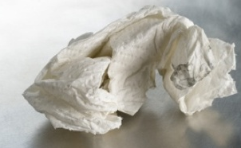
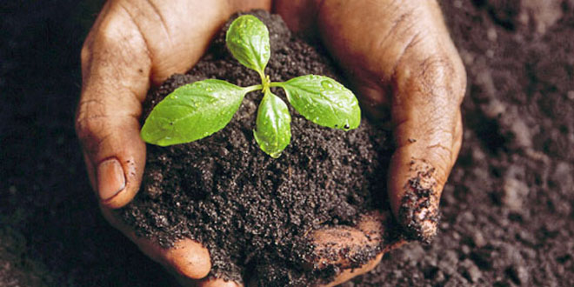
Turning organic waste into soil
Composting is...
AIR
WATER

Slide 4
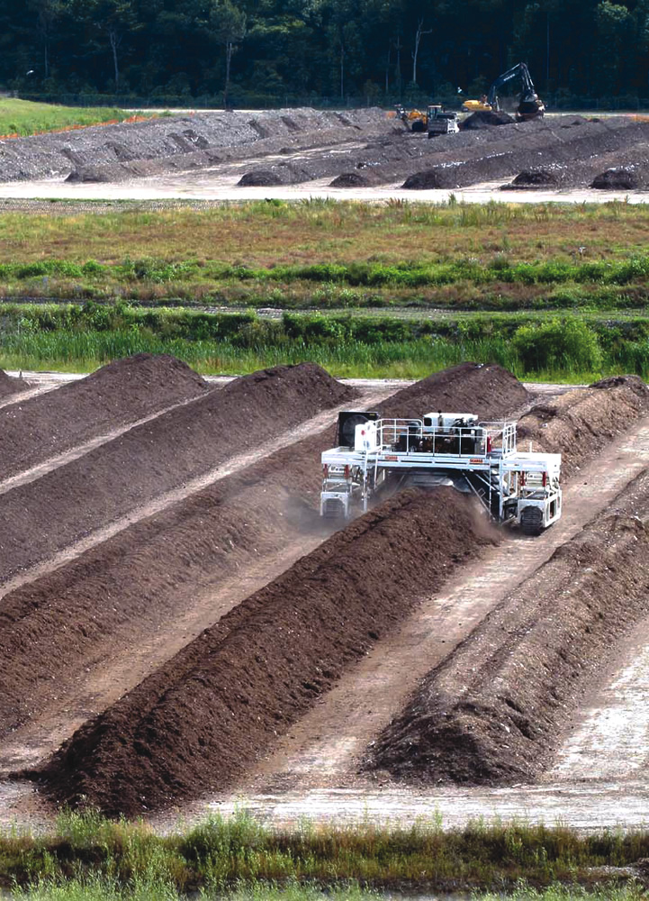
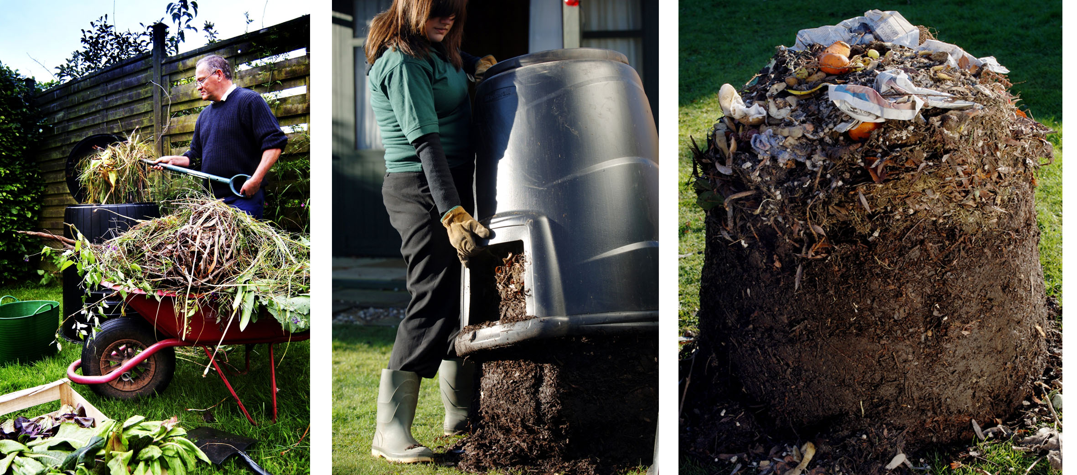
Taking a natural process and speeding it up
Composting is...
Notes:
What would take 6 months to a year in natural conditions, can take as little as 2 weeks with enough volume and effort
Image sources:
http://www.somersetwaste.gov.uk/wp-content/uploads/2012/01/Home_comp_tips_banner_edited-1.jpg
https://www.biocycle.net/2012/07/17/composting-roundup-19/

Slide 5
Why compost?
Part 2

Slide 6
We have a waste problem in the U.S.
Why Compost?
The average American sends nearly 1 ton of waste to the landfill each year
About 40% of all food produced in the US is never eaten
This means that 20% of our land, 4% of our energy, and 25% of our water is used to produce food that ends up being thrown out
Notes:
Sources:
https://www.statista.com/topics/2630/waste-management-in-the-united-states/
http://www.triplepundit.com/2014/10/food-waste-bigger-problem-think/
Image from http://greenactioncentre.ca/reduce-your-waste/why-should-i-compost/

Slide 7
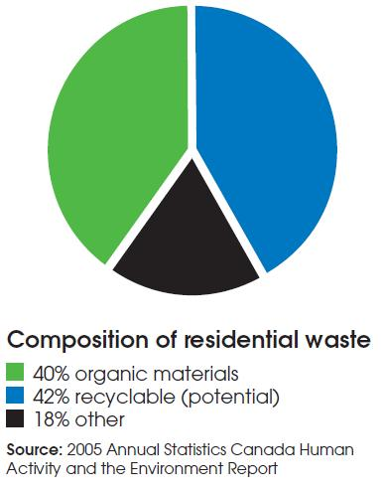
Why Compost?
Composting Means Less waste in landfills
Notes:
Image source: http://greenactioncentre.ca/reduce-your-waste/why-should-i-compost/

Slide 8
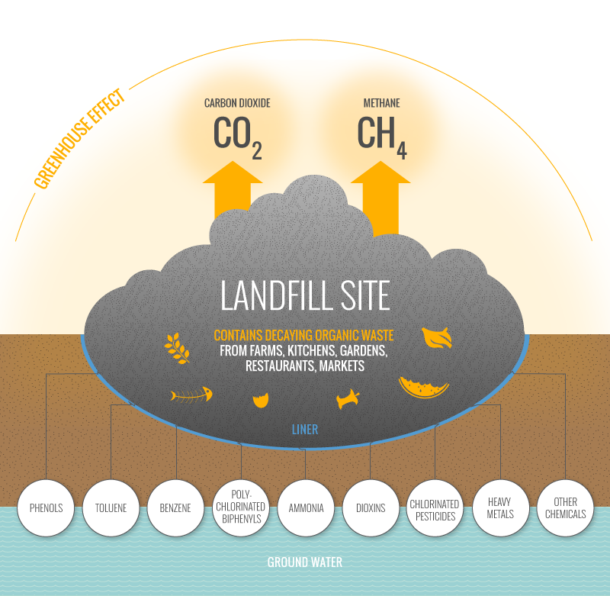
Why Compost?
Composting helps slow climate change and reduces pollution
Notes:
In landfills, compost large amounts of Methane, a greenhouse gas that is 72 times more potent than CO2
Landfills account for 20% methane in US
Trash in landfills also leaks pollution into the water table
So if you combine this information with that in the last slide, there’s a lot of excess gas and pollution being created that doesn’t need to be
Sources:
http://gazasia.com/biogas-source/landfill-sites-2/
https://ilsr.org/state-of-composting/

Slide 9
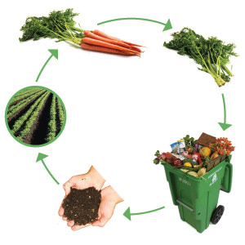
Why Compost?
Composting turns food waste back into food
Compost makes for healthier plants:
Drains better, retains water better
Has the nutrients that plants need in a “slow-release” form
And a healthier community:
Keeps nutrients local, reducing the need for chemical fertilizers (which cost money and cause pollution)
Notes:
When you grow food, it takes nutrients out of the soil. If the food waste gets put in the trash, those nutrients never make it back into the food chain.
With composting, instead of exporting nutrients and then having to import them again using fertilizers, we recycle them.
Compost nutrients actually work better than chemical ones (less costly, better drainage, more constant food)
Source: http://greenactioncentre.ca/reduce-your-waste/why-should-i-compost/

Slide 10
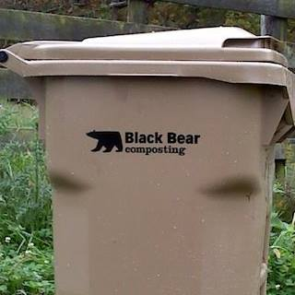
Composting with black bear
Part 3

Slide 11
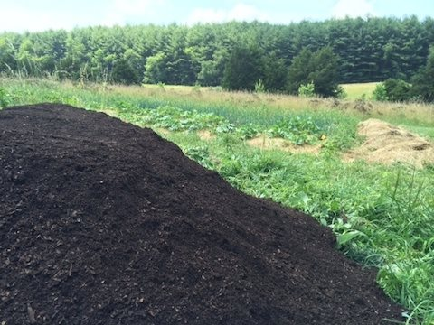
About Black Bear Composting
Located on a 47 acre farm in Augusta County
Founded in 2010
Already comes to Harrisonburg for compost pickup

Slide 12
Working with Black Bear means...
More Composting + Convenience
ALL food – even oils and meats
  Leftovers from lunch!
Soiled paper and cardboard
Twice monthly curbside pickup
Dedicated composting bin that is exchanged for a clean one each time

Slide 13

Compostable Materials
All food -- veggies, fruit, meat, oils (in small amounts), bones, etc
Paper Towels
Uncoated Paper*
Uncoated Cardboard*
Newspapers*
Yard trimmings (grass, leaves, wood, mulch)
Toilet paper and cardboard rolls
Pet waste (if placed in compostable bag)
Compostable plastics with the BPI label:
* Staples, tape, and other non-paper items should be removed
Notes:
Source: http://www.blackbearcomposting.com/compostable-materials.php

Slide 14
How to Compost (SAMPLE SLIDE)
Composting
There will be compost bins in the kitchen and bathroom (they are on the way)
I’ll be working with Black Bear to get signs made so we know exactly what can be composted and what can’t
Important not to put trash in the compost bins – it makes the compost unusable
Emptying compost
When full, bags get emptied into the big black bear bin in the storage shed
Black Bear will pick up bin every other week and drop off a clean one
Be sure to use compostable bags in the kitchen and bathroom compost bins!
Notes:
Everyone please participate...let’s set an example!

Slide 15
Questions?

